Slide 1
Jenkins Introduction
Shalini Mittal
Corporate Trainer, Developer & Consultant

Slide 2
Continuous Integration ?

Slide 3
Continuous Integration ?
Reduction of integration links: All projects employ more than one person to develop and it greatly increases the risk of errors during integration. Depending on the complexity of the code, it is possible that a lot of changes would have to be made. Here comes CI to the rescue and helps alleviate the issues as it allows for regular integration.
Higher quality of code: As the risks drastically reduce, a lot of the time and manpower can be diverted to creating a much more functionality-oriented code.
Code in version control works: Committing something that breaks the build immediately triggers a notification thereby preventing anyone from pulling a broken code.
Ease of testers: Retaining the different versions and builds of the code eases the work of QAs to understand, locate, and trace bugs efficiently.
Decreased deployment time: Automating the process of deployment eases and frees up a lot of time and manpower.
Increased confidence: The absence of a possible failure or breakdown gives developers peace of mind and thereby helps in delivering greater productivity and higher quality products.

Slide 4
Different tools
Continuous Integration Server (Jenkins, Bamboo, CruiseControl, TeamCity, and others)
Source Control Tool (e.g., CVS, SVN, GIT, Mercurial, Perforce, ClearCase and others)
Build tool (Make, ANT, Maven, Ivy, Gradle, and others)
Automation testing framework (Selenium, Appium, TestComplete, UFT, and others)

Slide 5
What ?
Open Source Continuous Integration Server
Capable of orchestrating a chain of actions that help to achieve the Continuous Integration process (and not only) in an automated fashion.
Entirely written in Java.
A server-based that provides monitoring of repeated tasks which arise during the development of a project. Software companies can accelerate their software development process, as Jenkins can automate build and test at a rapid rate.
Jenkins supports the complete development lifecycle of software from building, testing, documenting the software, deploying and other stages of a software development lifecycle.
Notes:
For example, if your team is developing a project, Jenkins will continuously test your project builds and show you the errors in early stages of your development.

Slide 6
HIstory ?
Kohsuke Kawaguchi, a Java developer, working at SUN Microsystems, was tired of building the code and fixing errors repetitively. In 2004, created an automation server called Hudson that automates build and test task.
In 2011, Oracle who owned Sun Microsystems had a dispute with Hudson open source community, so they forked Hudson and renamed it as Jenkins.
Both Hudson and Jenkins continued to operate independently. But in short span of time, Jenkins acquired a lot of projects and contributors while Hudson remained with only 32 projects. With time, Jenkins became more popular, and Hudson is not maintained anymore.
Notes:
For example, if your team is developing a project, Jenkins will continuously test your project builds and show you the errors in early stages of your development.

Slide 7
Features ?
Jenkins allows to execute a predefined list of steps, e.g. to compile Java source code and build a JAR from the resulting classes. The trigger for this execution can be time or event based.
For example, you can compile your Java based application every 20 minutes or after a new commit in the related Git repository.
Possible steps executed by Jenkins are for example:
perform a software build using a build system like Apache Maven or Gradle
execute a shell script
archive a build result
run software tests
Jenkins can be extended by additional plug-ins. For example, you can install plug-ins to support building and testing Android applications.

Slide 8
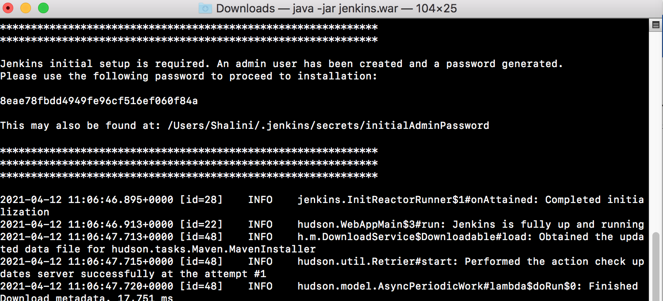
Jenkins Download and Install
Download the war file : https://www.jenkins.io/download/
Run Jenkins using command java -jar jenkins*.war
Open browser and Jenkins is running on localhost:8080
Save the password created by Jenkins first time the war is run from cmd or terminal
https://www.vogella.com/tutorials/Jenkins/article.html
Notes:
-Dhttps.protocols=TLSv1,TLSv1.1,TLSv1.2
java -Djavax.net.ssl.trustStore="/scratch/install/jdk1.8.0_102/jre/lib/security/cacerts" -jar jenkins.war &
jenkins password
6b177504d23c40e08c50f492c5d568f8
first admin username :shalini
password : shalini
java -jar jenkins.war --httpPort=8080.
If the jenkins.war is deployed in your webapps directory, but cannot be started and the tomcat manager says ﻿FAIL - Application at context path /jenkins could not be started, you may need to grant the permissons for ﻿JENKINS_HOME.
﻿sudo mkdir .jenkins ﻿sudo chown tomcat7:nogroup .Jenkins
This makes the .jenkins folder writable and Jenkins can use it.

Slide 9
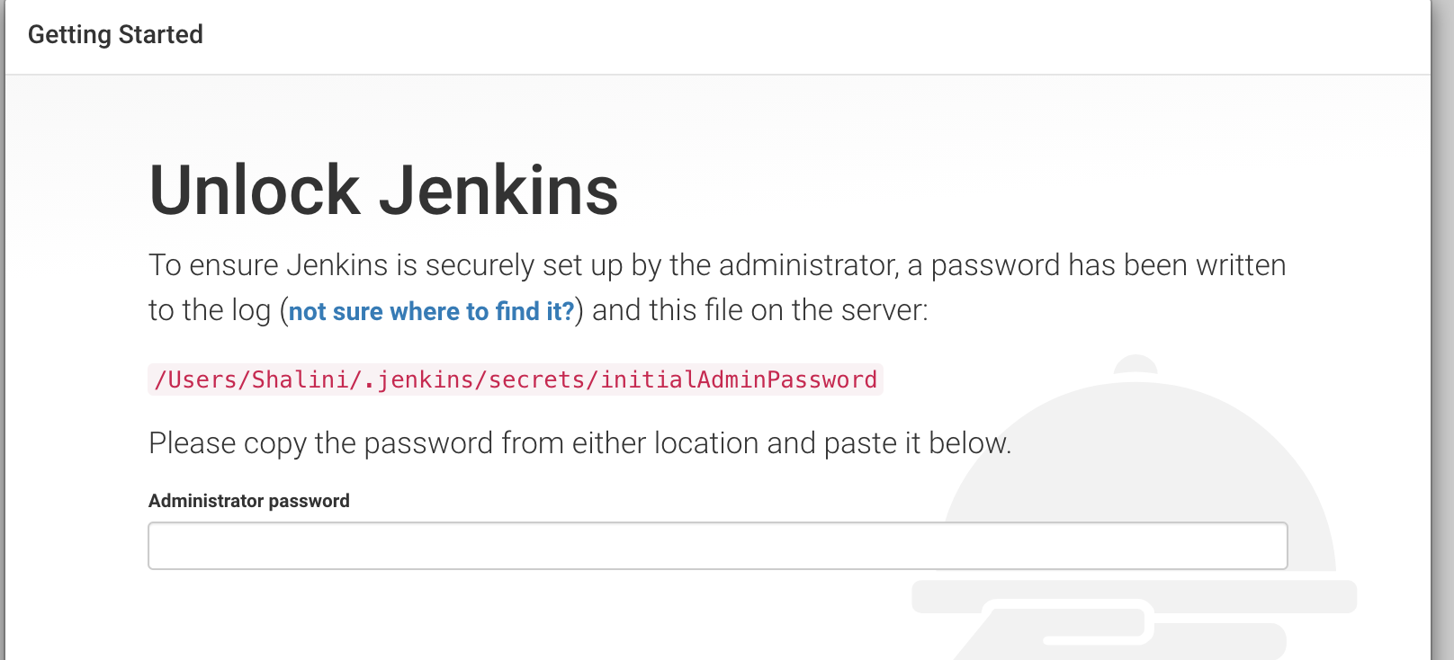
Jenkins website
Give the password when open Jenkins on the browser with url http://localhost:8080
Notes:
jenkins password
6b177504d23c40e08c50f492c5d568f8
first admin username :shalini
password : shalini
java -jar jenkins.war --httpPort=8080.
If the jenkins.war is deployed in your webapps directory, but cannot be started and the tomcat manager says ﻿FAIL - Application at context path /jenkins could not be started, you may need to grant the permissons for ﻿JENKINS_HOME.
﻿sudo mkdir .jenkins ﻿sudo chown tomcat7:nogroup .Jenkins
This makes the .jenkins folder writable and Jenkins can use it.

Slide 10
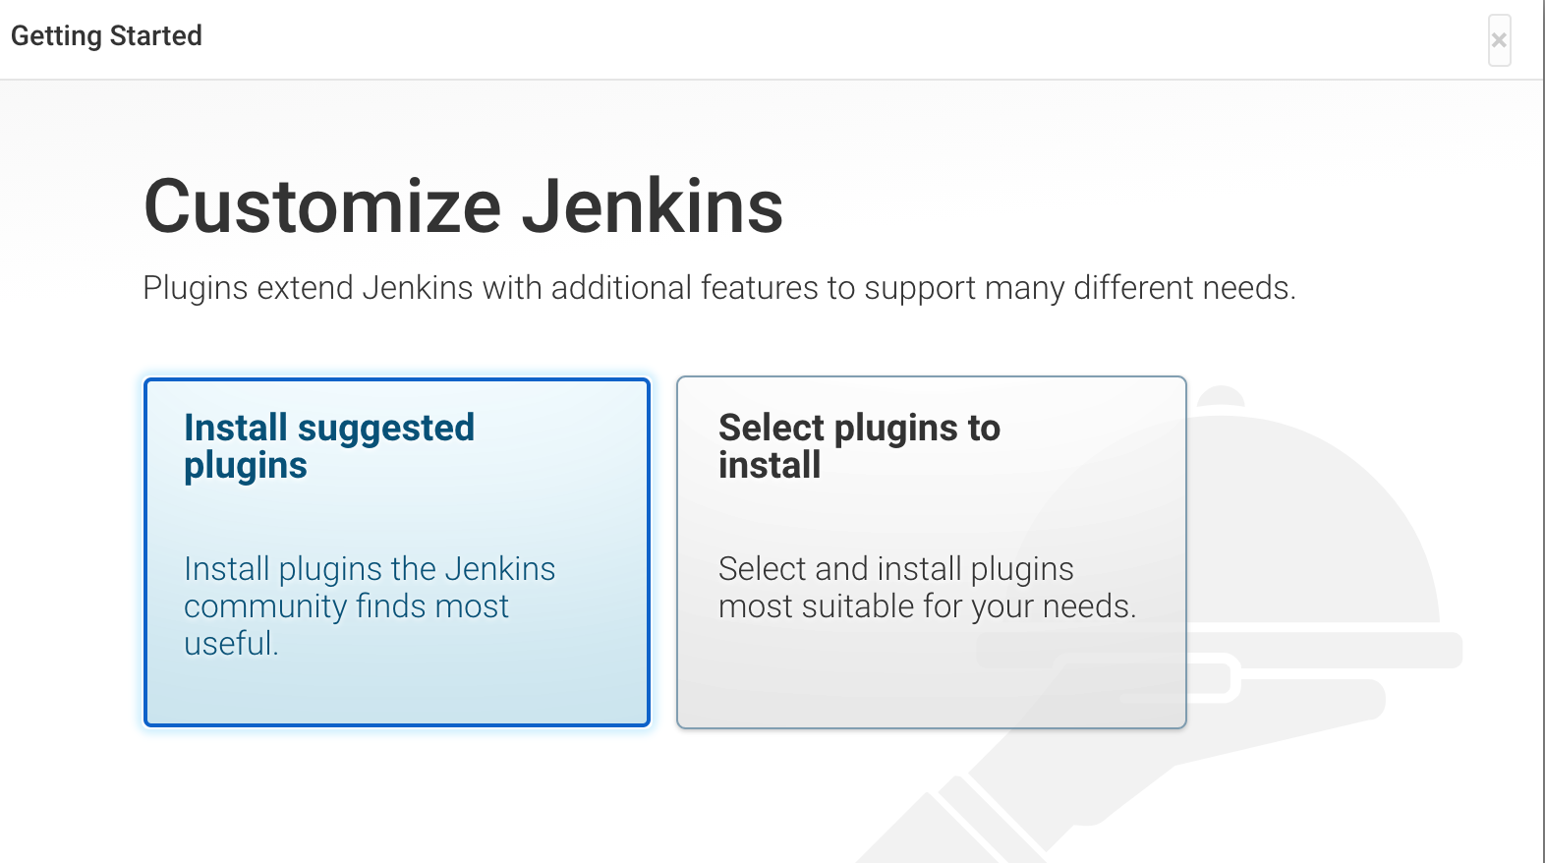
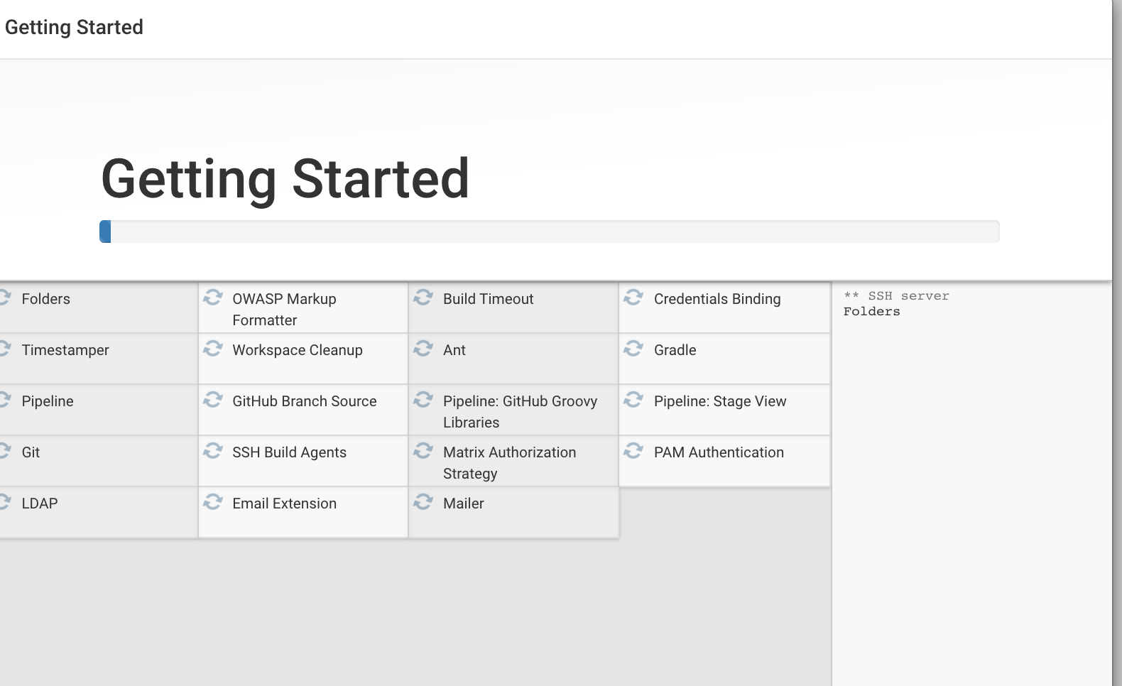
Jenkins dashboard
Once you enter the password, you get the following screen.
Click Install suggested plugins
Then it will start looking for plugins. Please wait the getting started screen will take time
Notes:
jenkins password
6b177504d23c40e08c50f492c5d568f8
first admin username :shalini
password : shalini
java -jar jenkins.war --httpPort=8080.
If the jenkins.war is deployed in your webapps directory, but cannot be started and the tomcat manager says ﻿FAIL - Application at context path /jenkins could not be started, you may need to grant the permissons for ﻿JENKINS_HOME.
﻿sudo mkdir .jenkins ﻿sudo chown tomcat7:nogroup .Jenkins
This makes the .jenkins folder writable and Jenkins can use it.

Slide 11
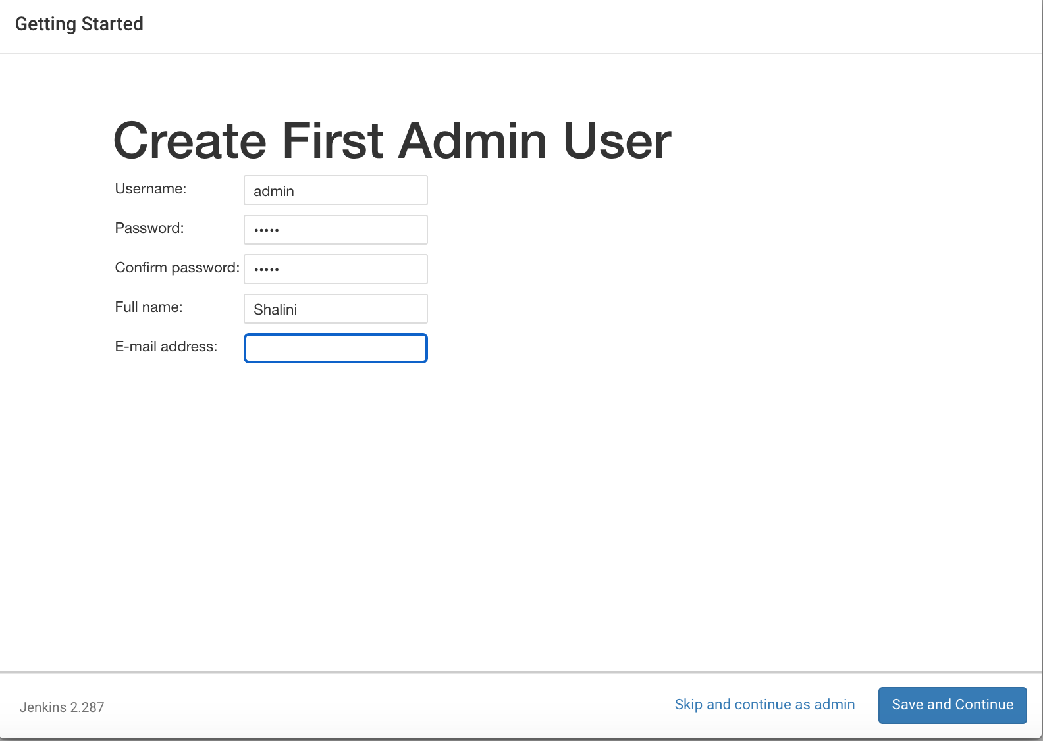
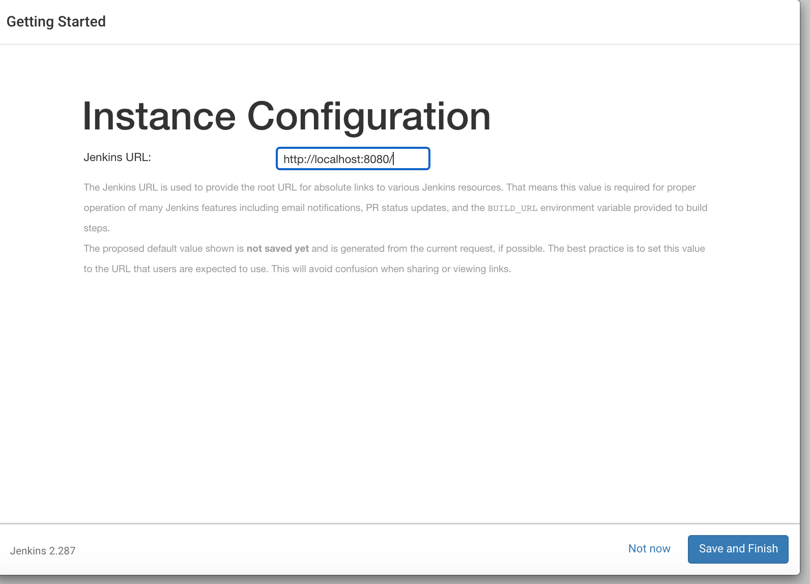
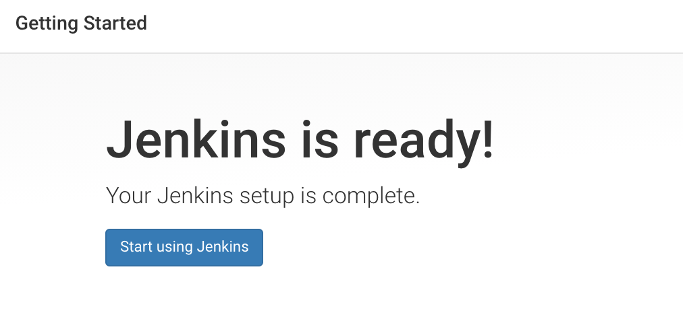
Jenkins Login
After the setup is installed, create first admin user and do remember the username and password.
I added following:
first admin username :admin
password : admin
Then it provides with default url. Just say Save and Finish.
Lastly you should get Jenkins is ready. Click start using jenkins
Notes:
jenkins password 8eae78fbdd4949fe96cf516ef060f84a
first admin username :admin
password : admin
java -jar jenkins.war --httpPort=8080.
If the jenkins.war is deployed in your webapps directory, but cannot be started and the tomcat manager says ﻿FAIL - Application at context path /jenkins could not be started, you may need to grant the permissons for ﻿JENKINS_HOME.
﻿sudo mkdir .jenkins ﻿sudo chown tomcat7:nogroup .Jenkins
This makes the .jenkins folder writable and Jenkins can use it.

Slide 12
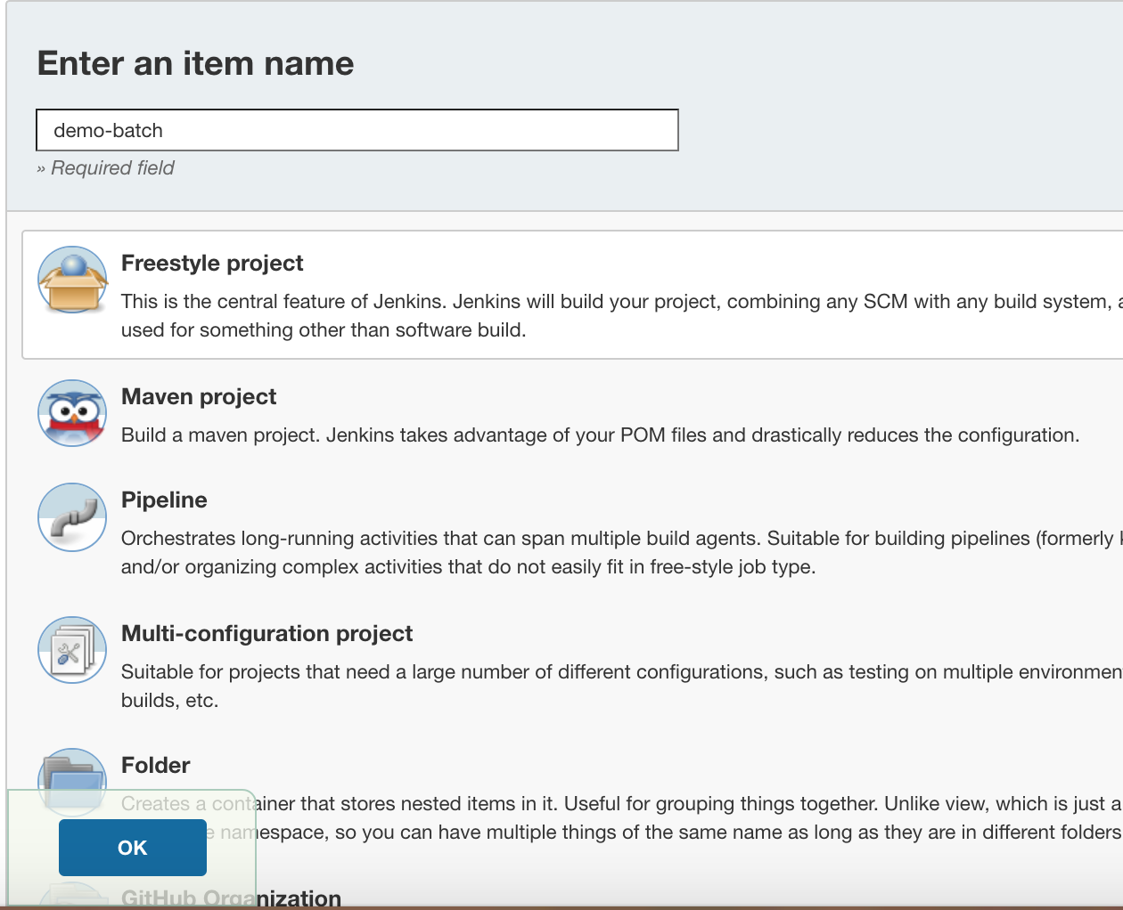
Set Jenkins Job For windows batch
The build of a project is handled via jobs in Jenkins. Select New Item. Afterwards, enter a name for the job and select Freestyle project and press OK.
Notes:
https://www.softwaretestingmaterial.com/execute-maven-project-using-jenkins/

Slide 13
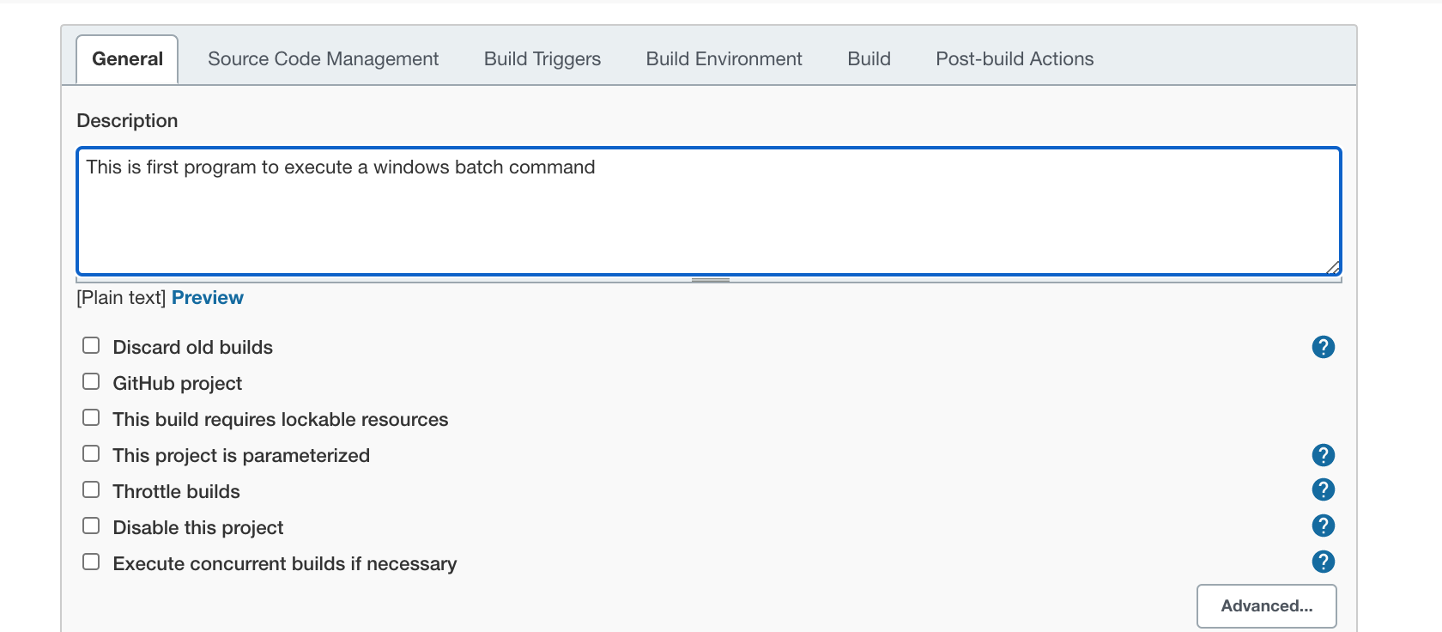
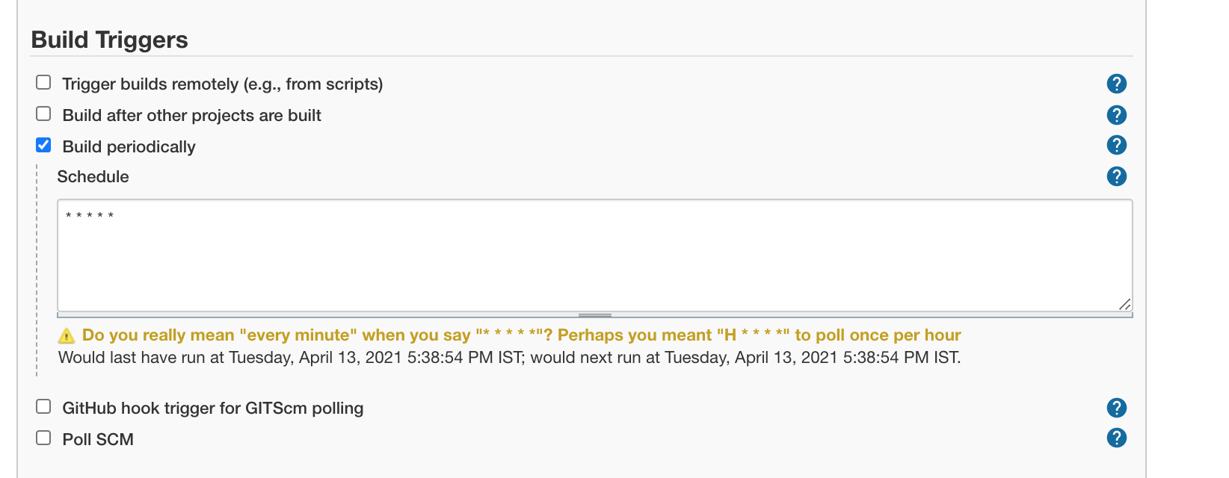
Description
Schedule
Lets schedule to build periodically
Notes:
https://www.softwaretestingmaterial.com/execute-maven-project-using-jenkins/

Slide 14
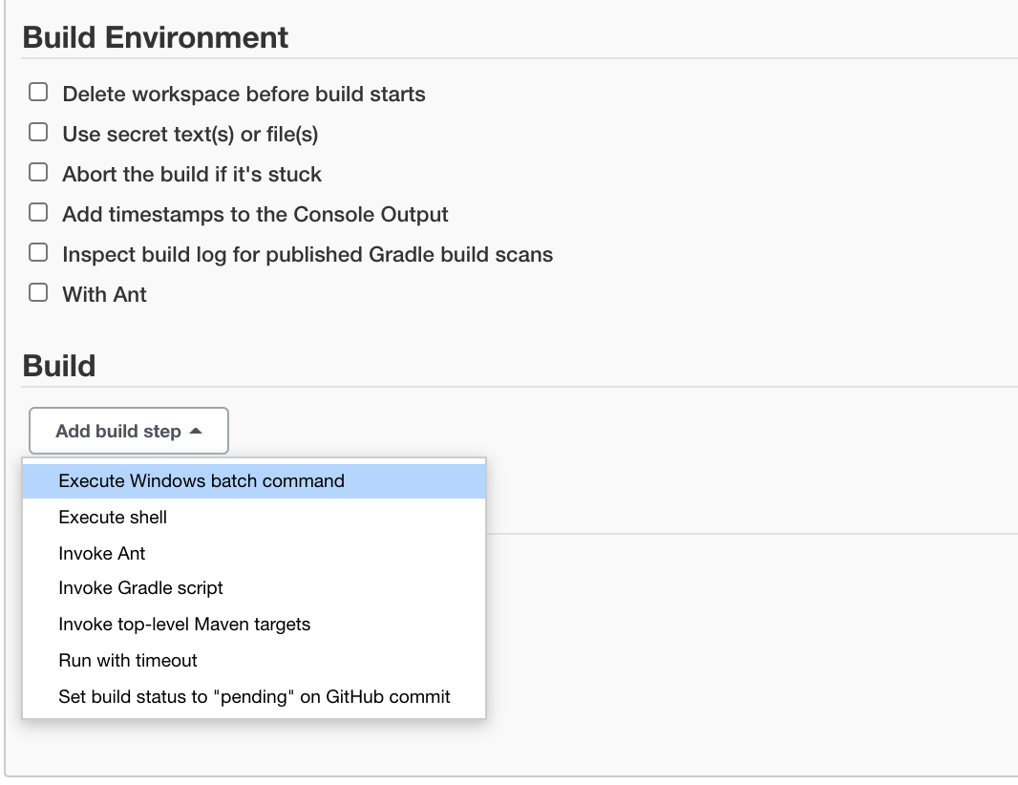
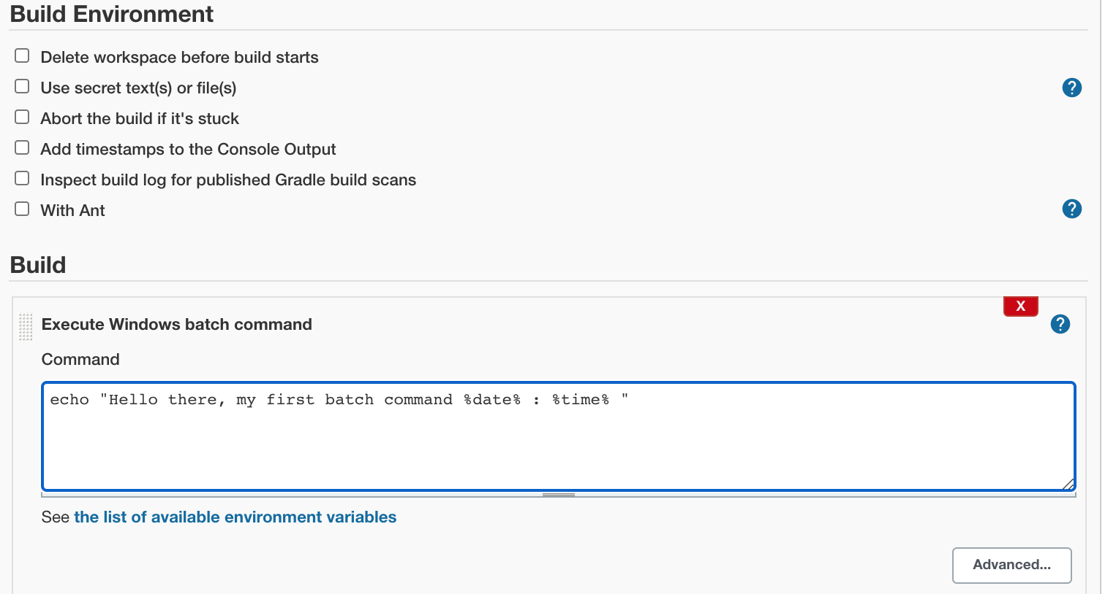
Build command
Go to Build and select Execute Windows batch command.
Add the command: echo "Hello my first jenkins job windows batch %date% : %time% ”.
The click save
Notes:
FOR MAC to set date and time : https://tecadmin.net/get-current-date-and-time-in-bash/
CURRENTDATE=`date +"%Y-%m-%d %T"`
CURRENTDATEONLY=`date +"%b %d, %Y"`
CURRENTEPOCTIME=`date +"%Y-%m-%d %T"`
echo Current Date is: ${CURRENTDATEONLY}
echo Current Date and Time is: `date +"%Y-%m-%d %T"`
echo Current Date and Time is: ${CURRENTDATE}
echo Current Unix epoch time is: ${CURRENTEPOCTIME}

Slide 15
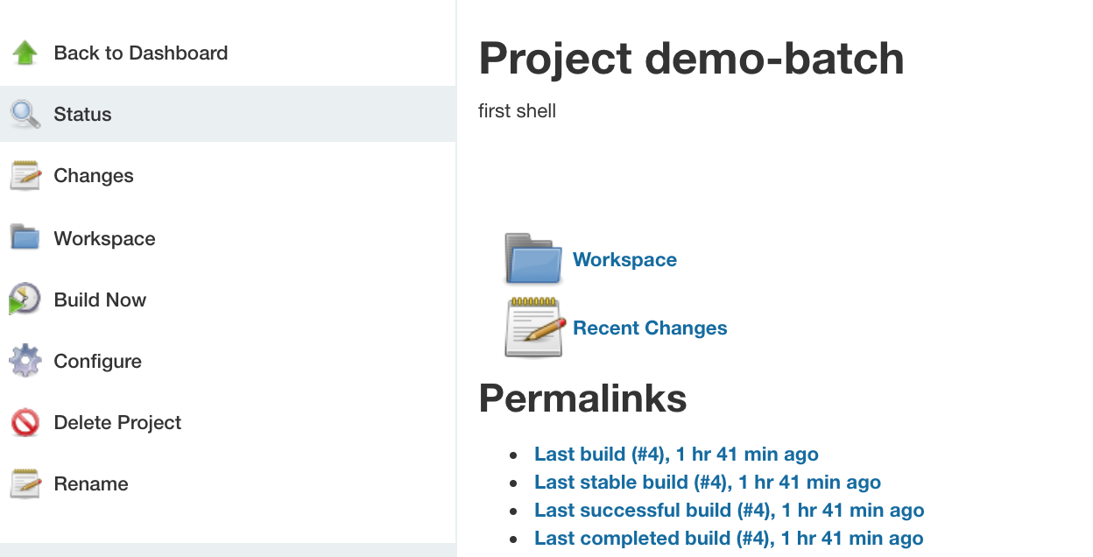
Execute Job
Then click on Build now or as we have scheduled it to run every minute, wait it will run automatically in a minute
Notes:
FOR MAC to set date and time : https://tecadmin.net/get-current-date-and-time-in-bash/
CURRENTDATE=`date +"%Y-%m-%d %T"`
CURRENTDATEONLY=`date +"%b %d, %Y"`
CURRENTEPOCTIME=`date +"%Y-%m-%d %T"`
echo Current Date is: ${CURRENTDATEONLY}
echo Current Date and Time is: `date +"%Y-%m-%d %T"`
echo Current Date and Time is: ${CURRENTDATE}
echo Current Unix epoch time is: ${CURRENTEPOCTIME}

Slide 16
Set Jenkins Job For maven local project
The build of a project is handled via jobs in Jenkins. Select New Item. Afterwards, enter a name for the job and select Freestyle project and press OK.
Notes:
https://www.softwaretestingmaterial.com/execute-maven-project-using-jenkins/

Slide 17
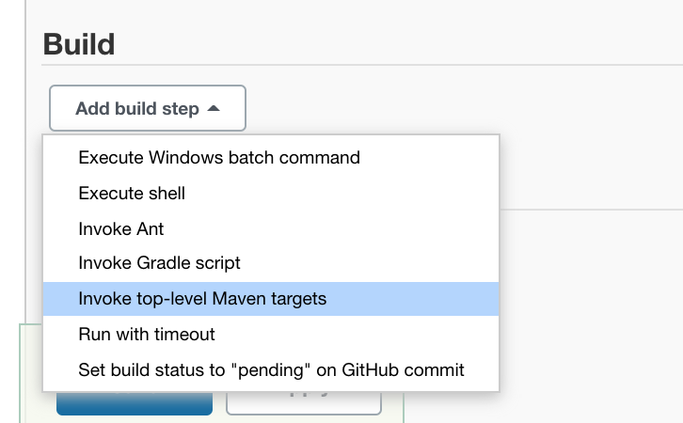
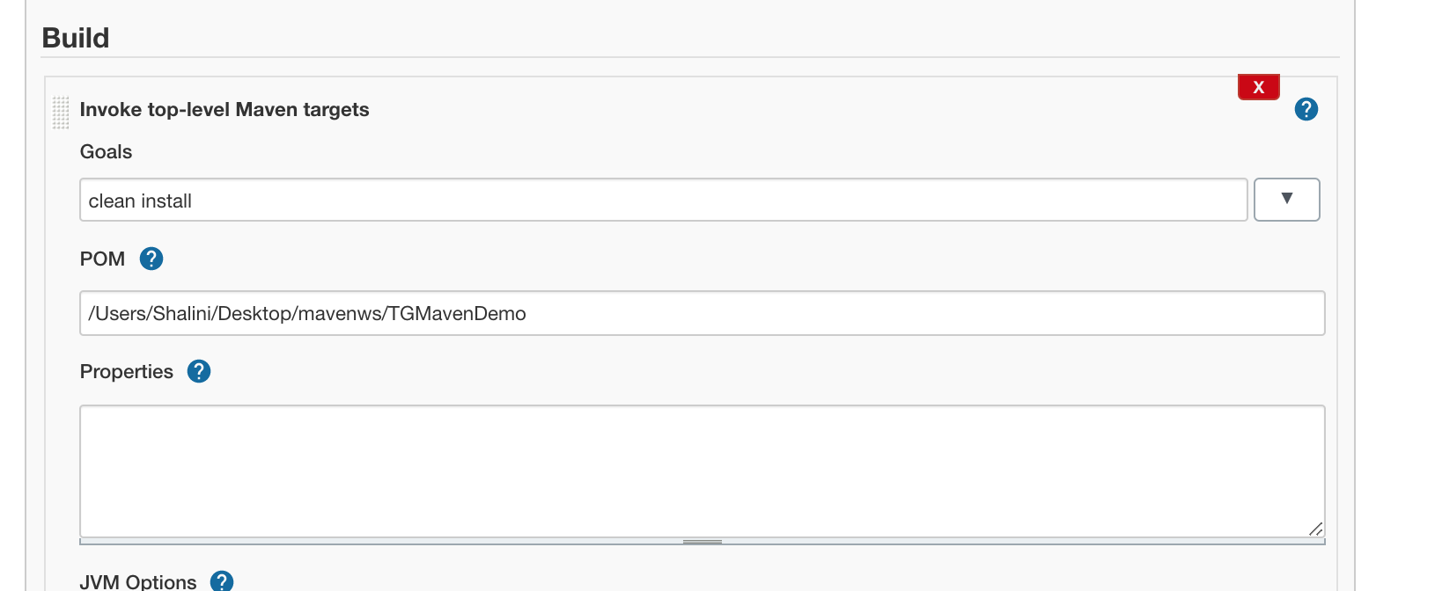
Set Maven Project
Go to Build and enter the following.
Click on Save.
It goes to your project dashboard.
Now click on Build now
It will build the project successfully
Notes:
https://www.softwaretestingmaterial.com/execute-maven-project-using-jenkins/

Slide 18
Set Maven Command
Go to Build and enter the following.
Click on Save. It goes to your project dashboard. Now click on Build now
It will build the project successfully
Notes:
https://www.softwaretestingmaterial.com/execute-maven-project-using-jenkins/

Slide 19
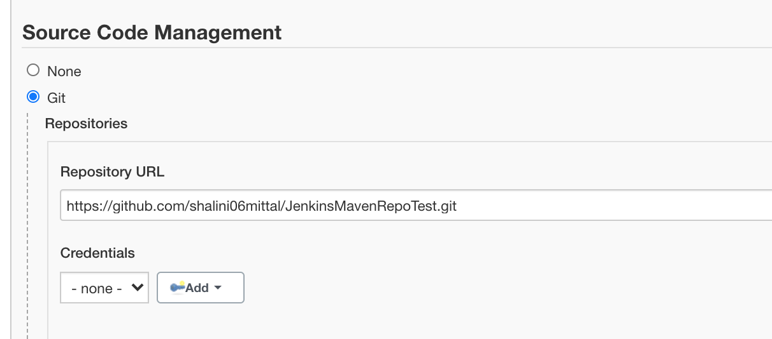
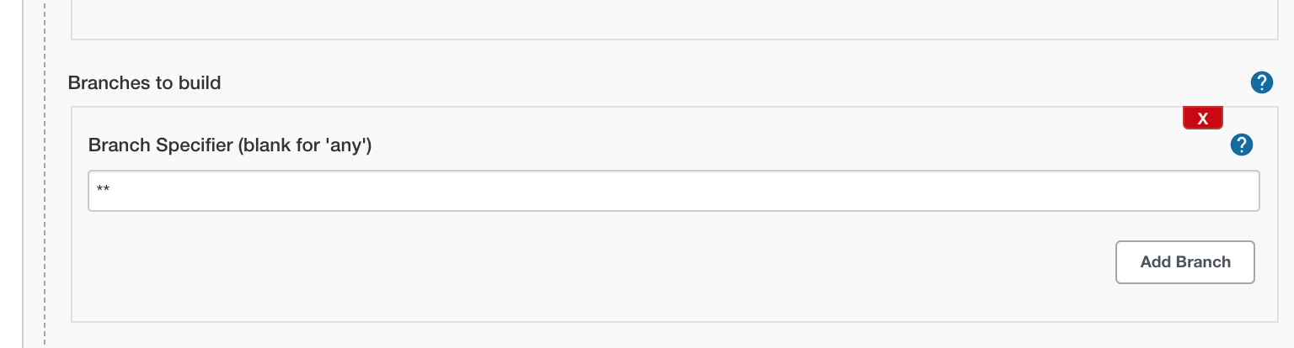
Execute Git Repo
Select New item and enter item name , freestyle and click ok.
Add description as we did before
Go to Source Code Management and the url of the git repo.
This should be blank or **
Notes:
https://www.softwaretestingmaterial.com/execute-maven-project-using-jenkins/

Slide 20
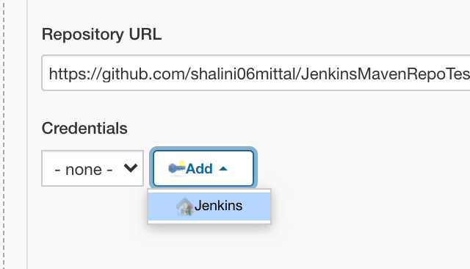
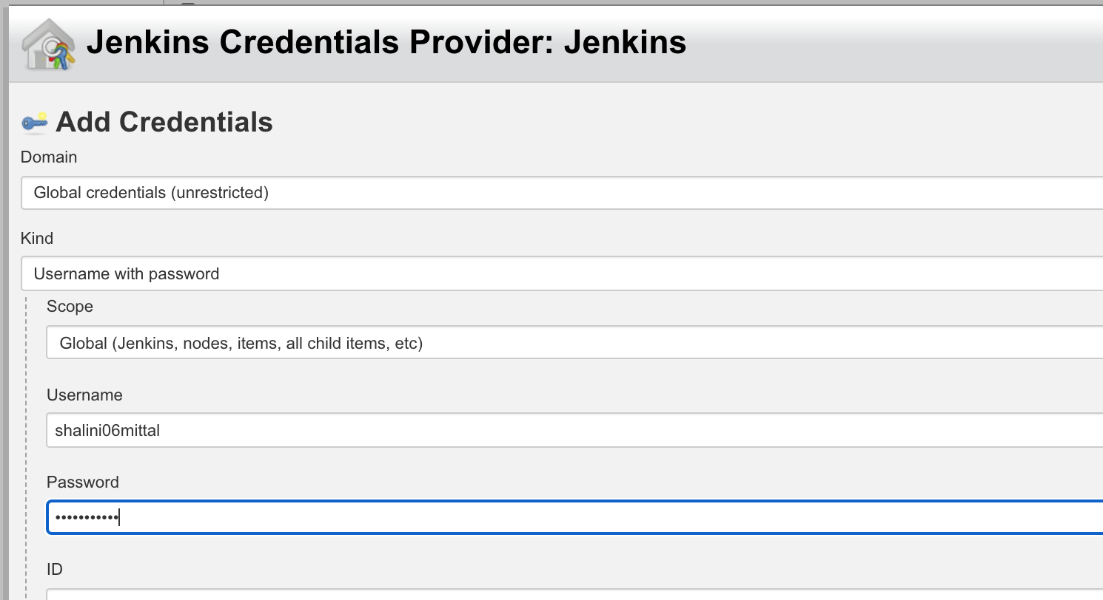
Git Credentials
Select Add -> Jenkins.
Then add git credentials for Jenkins to pull the repository on your behalf
Notes:
https://www.softwaretestingmaterial.com/execute-maven-project-using-jenkins/

Slide 21
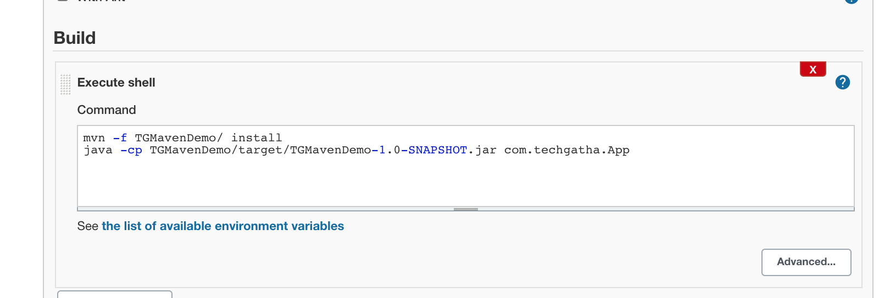
Add Build command
Under Build, select Add Build Step -> Execute windows batch command.
Add the following.
Here mvn –f is used as pom.xml is within the project TGMavenDemo
Then save and click on Build now. It should successfully execute and display the output
mvn -f MavenDemo/ install java -cp MavenDemo/target/MavenDemo-1.0-SNAPSHOT.jar com.hcl.MavenDemo.App

Slide 22
Jenkins Tomcat
To run it in your Tomcat server, put the .war file into the webapps directory. If you start Tomcat, your Jenkins installation will be available under
http://localhost:8080/jenkins
select to install plug-ins. Select the Install suggested plug-ins to get a typical configuration.
Create an admin user and press Save and Finish.
Notes:
jenkins password
6b177504d23c40e08c50f492c5d568f8
first admin username :shalini
password : shalini
java -jar jenkins.war --httpPort=8080.
If the jenkins.war is deployed in your webapps directory, but cannot be started and the tomcat manager says ﻿FAIL - Application at context path /jenkins could not be started, you may need to grant the permissons for ﻿JENKINS_HOME.
﻿sudo mkdir .jenkins ﻿sudo chown tomcat7:nogroup .Jenkins
This makes the .jenkins folder writable and Jenkins can use it.

Slide 23
Integrate Selenium with jenkins
Create a Selenium Maven Project
Add selenium and testing jar files
Creating a TestNG class named NewTest
Converting the project into TestNG and changing the run configuration
Running the project as Maven test
Adding Maven plugins to Jenkins
In the Jenkins dashboard, click on Manage Jenkins
Click on Manage Plugins
Select the Available tab, then find the Maven Integration plugin
Click Install without restart
Adding the location of pom.xml in Jenkins CI Job
Click on New Item to create CI Job
Select the Maven project radio button and enter Item Name as SeleJenk
Click on Build Environment
In Root POM, specify the location of pom.xml from your Eclipse workspace
In Goals and Options, type clean test. Click on Save
Click on the SeleJenk project page and click on the Build Now link
https://www.softwaretestingmaterial.com/execute-maven-project-using-jenkins/
Notes:
jenkins password
6b177504d23c40e08c50f492c5d568f8
java -jar jenkins.war --httpPort=8080.
https://github.com/samarpit1111/devops_pipeline_demo
If the jenkins.war is deployed in your webapps directory, but cannot be started and the tomcat manager says ﻿FAIL - Application at context path /jenkins could not be started, you may need to grant the permissons for ﻿JENKINS_HOME.
﻿sudo mkdir .jenkins ﻿sudo chown tomcat7:nogroup .Jenkins
This makes the .jenkins folder writable and Jenkins can use it.

Slide 24
Jenkins Pipeline
Jenkins Pipeline is a combination of plugins that supports integration and implementation of continuous delivery pipelines.
It has an extensible automation server to create simple and complex delivery pipelines as code via pipeline DSL.
A Pipeline is a group of events interlinked with each other in a sequence.
Notes:
jenkins password
6b177504d23c40e08c50f492c5d568f8
java -jar jenkins.war --httpPort=8080.
https://github.com/samarpit1111/devops_pipeline_demo
If the jenkins.war is deployed in your webapps directory, but cannot be started and the tomcat manager says ﻿FAIL - Application at context path /jenkins could not be started, you may need to grant the permissons for ﻿JENKINS_HOME.
﻿sudo mkdir .jenkins ﻿sudo chown tomcat7:nogroup .Jenkins
This makes the .jenkins folder writable and Jenkins can use it.

Slide 25
Continuous Delivery Pipeline
In a Jenkins pipeline, every job or event has some sort of dependency on at least one or more events.
Jenkins pipeline consists of group of state and every state has its own events as shown in the diagram below
A continuous delivery pipeline is an automated expression to display your process for getting software for version control. Thus, every change made in your software goes through a number of complex processes on its way to being released. It also involves developing the software in a reliable and repeatable manner, and progression of the built software through multiple stages of testing and deployment.
Notes:
The picture above represents a continuous delivery pipeline in Jenkins. It contains a group of states called build, deploy, test and release. These events are interlinked with each other. Every state has its events, which work in a sequence called a continuous delivery pipeline.

Slide 26
JenkinsFile
Jenkins pipelines can be defined using a text file called JenkinsFile. You can implement pipeline as code using JenkinsFile, and this can be defined by using a domain specific language (DSL). With JenkinsFile, you can write the steps needed for running a Jenkins pipeline.
The benefits of using JenkinsFile are:
You can create pipelines automatically for all branches and execute pull requests with just one JenkinsFile.
You can review your Jenkins code on the pipeline
You can audit your Jenkins pipeline
This is the singular source for your pipeline and can be modified by multiple users.
JenkinsFile can be defined by either Web UI or with a Jenkins File.
Notes:
The picture above represents a continuous delivery pipeline in Jenkins. It contains a group of states called build, deploy, test and release. These events are interlinked with each other. Every state has its events, which work in a sequence called a continuous delivery pipeline.

Slide 27
Why Jenkins Pipeline
Jenkins is an open continuous integration server which has the ability to support the automation of software development processes. You can create multiple automation jobs with the help of use cases, and run them as a Jenkins pipeline.
Here are the reasons why you use should use Jenkins pipeline:
Jenkins pipeline is implemented as a code which allows multiple users to edit and execute the pipeline process.
Pipelines are robust. So if your server undergoes an unforeseen restart, the pipeline will be automatically resumed.
You can pause the pipeline process and make it wait to resume until there is an input from the user.
Jenkins Pipelines support big projects. You can run multiple jobs, and even use pipelines in a loop.
Notes:
The picture above represents a continuous delivery pipeline in Jenkins. It contains a group of states called build, deploy, test and release. These events are interlinked with each other. Every state has its events, which work in a sequence called a continuous delivery pipeline.

Slide 28
Reference
https://iroshandu.medium.com/build-spring-boot-maven-project-with-jenkins-and-copy-the-artifact-in-to-local-directory-c2910b8ba278
https://github.com/samarpit1111/devops_pipeline_demo
https://medium.com/avmconsulting-blog/automated-ci-cd-with-jenkins-39b21c7c8035
https://www.guru99.com/jenkins-tutorial.html
https://www.simplilearn.com/tutorials/jenkins-tutorial
https://www.jenkins.io/doc/book/pipeline/getting-started/ => first pipeline example
https://www.jenkins.io/doc/pipeline/tour/hello-world/
https://www.jenkins.io/doc/book/pipeline/syntax/
https://www.jenkins.io/doc/pipeline/examples/
https://gitlab.com/nanuchi/techworld-js-docker-demo-app/-/tree/dev
https://www.youtube.com/watch?v=7KCS70sCoK0
http://localhost:8080/env-vars.html/ => environment variables list
https://www.edureka.co/community/49753/auto-build-job-jenkins-there-change-code-github-repository
Notes:
jenkins password
6b177504d23c40e08c50f492c5d568f8
java -jar jenkins.war --httpPort=8080.
If the jenkins.war is deployed in your webapps directory, but cannot be started and the tomcat manager says ﻿FAIL - Application at context path /jenkins could not be started, you may need to grant the permissons for ﻿JENKINS_HOME.
﻿sudo mkdir .jenkins ﻿sudo chown tomcat7:nogroup .Jenkins
This makes the .jenkins folder writable and Jenkins can use it.

Slide 29

Any Question ?

Slide 30
Thank you !

